Slide 1
Software Engineering
Lecture 05
UML

Slide 2
Outline
What is UML and why we use UML?
How to use UML diagrams to design software system?
What UML Modeling tools we use today?

Slide 3
What is UML and Why we use UML?
UML → “Unified Modeling Language”
Language: express idea, not a methodology
Modeling: Describing a software system at a high level of abstraction
Unified: UML has become a world standard
Object Management Group (OMG): www.omg.org

Slide 4
What is UML and Why we use UML?
More description about UML:
It is a industry-standard graphical language for specifying, visualizing, constructing, and documenting the artifacts of software systems
The UML uses mostly graphical notations to express the OO analysis and design of software projects.
Simplifies the complex process of software design

Slide 5
What is UML and Why we use UML?
Why we use UML?
Use graphical notation: more clearly than natural language (imprecise) and code (too detailed).
Help acquire an overall view of a system.
UML is not dependent on any one language or technology.
UML moves us from fragmentation to standardization.

Slide 6

Overview of UML Diagrams
Structural
: element of spec. irrespective of time
Class
Component
Deployment
Object
Composite structure
Package
Behavioral
: behavioral features of a system / business process
Activity
State machine
Use case
Interaction
Interaction
: emphasize object interaction
Communication(collaberation)
Sequence
Interaction overview
Timing

Slide 7
How to use UML diagrams to design software system?
Types of UML Diagrams:
Use Case Diagram
Class Diagram
Sequence Diagram
Collaboration Diagram
State Diagram
This is only a subset of diagrams … but are most widely used

Slide 8
Use-Case Diagrams
Use Case
Boundary
Actor
Library System
Borrow
Employee
Client
Order Title
Fine Remittance
Supervisor

Slide 9
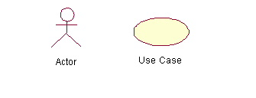
Use-Case Diagrams
Actors: A role that a user plays with respect to the system, including human users and other systems. e.g., inanimate physical objects (e.g. robot); an external system that needs some information from the current system.
Use case: A set of scenarios that describing an interaction between a user and a system, including alternatives.
System boundary: rectangle diagram representing the boundary between the actors and the system.

Slide 10
Use-Case Diagrams
Association:
communication between an actor and a use case; Represented by a solid line.
Generalization: relationship between one general use case and a special use case (used for defining special alternatives) Represented by a line with a triangular arrow head toward the parent use case.

Slide 11
Use-Case Diagrams
Include: a dotted line labeled <<include>> beginning at base use case and ending with an arrows pointing to the include use case. The include relationship occurs when a chunk of behavior is similar across more than one use case. Use “include” in stead of copying the description of that behavior.
<<include>>
Extend: a dotted line labeled <<extend>> with an arrow toward the base case. The extending use case may add behavior to the base use case. The base class declares “extension points”.
<<extend>>

Slide 12
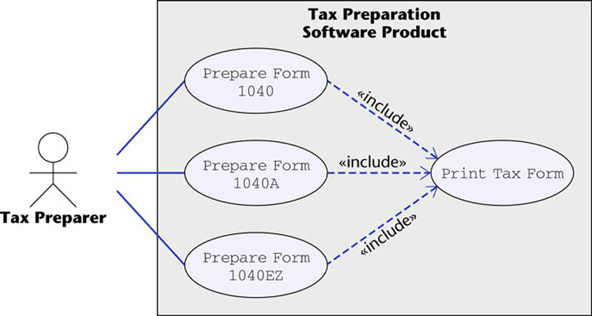
Use-Case Diagrams
Figure 16.12
The McGraw-Hill Companies, 2005

Slide 13
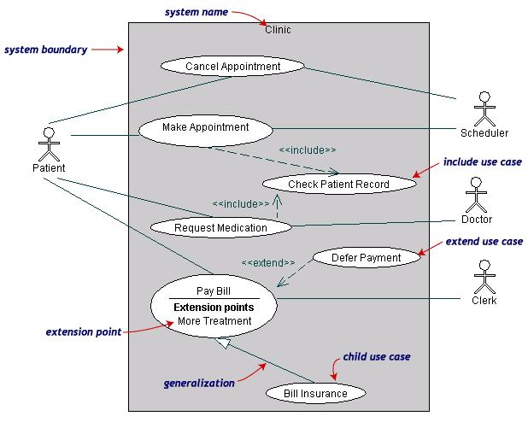
Use-Case Diagrams
Both Make Appointment and Request Medication include Check Patient Record as a subtask (include)
The extension point is written inside the base case Pay bill; the extending class Defer payment adds the behavior of this extension point. (extend)
Pay Bill is a parent use case and Bill Insurance is the child use case. (generalization)
(TogetherSoft, Inc)

Slide 14
Class diagram
A class diagram depicts classes and their interrelationships
Used for describing structure and behavior in the use cases
Provide a conceptual model of the system in terms of entities and their relationships
Used for requirement capture, end-user interaction
Detailed class diagrams are used for developers

Slide 15
Class diagram
Each class is represented by a rectangle subdivided into three compartments
  Name
  Attributes
  Operations
Modifiers are used to indicate visibility of attributes and operations.
  ‘+’ is used to denote Public visibility (everyone)
  ‘#’ is used to denote Protected visibility (friends and derived)
  ‘-’ is used to denote Private visibility (no one)
By default, attributes are hidden and operations are visible.

Slide 16
Class diagram
Name
Account_Name
- Customer_Name
- Balance
Attributes
+addFunds( )
+withDraw( )
+transfer( )
Operations

Slide 17
OO Relationships
There are two kinds of Relationships
  Generalization (parent-child relationship)
  Association (student enrolls in course)
Associations can be further classified as
  Aggregation
  Composition

Slide 18
OO Relationships: Generalization
Supertype
Example:
Customer
Regular
Customer
Loyalty
Customer
Subtype1
Subtype2
-Inheritance is a required feature of object orientation
-Generalization expresses a parent/child relationship among related classes.
Used for abstracting details in several layers

Slide 19
OO Relationships: Association
Represent relationship between instances of classes
  Student enrolls in a course
  Courses have students
  Courses have exams
  Etc.
Association has two ends
  Role names (e.g. enrolls)
  Multiplicity (e.g. One course can have many students)
  Navigability (unidirectional, bidirectional)

Slide 20
Association: Multiplicity and Roles
student
1
*
University
Person
0..1
*
employer
teacher
Multiplicity
Symbol Meaning
1 One and only one
0..1 Zero or one
M..N From M to N (natural language)
* From zero to any positive integer
0..* From zero to any positive integer
1..* From one to any positive integer
Role
Role
“A given university groups many people; some act as students, others as teachers. A given student belongs to a single university; a given teacher may or may not be working for the university at a particular time.”

Slide 21
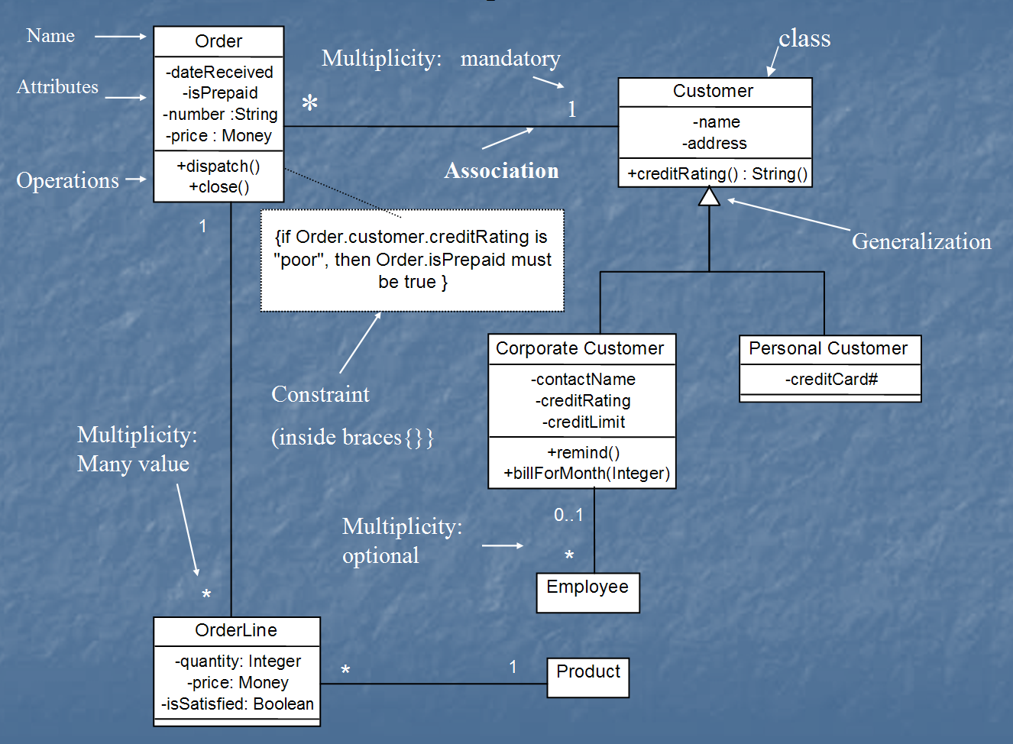
Class diagram
[from UML Distilled Third Edition]

Slide 22
Association: Model to Implementation
*
4
Student
Course
has
enrolls
Class Student {
Course enrolls[4];
}
Class Course {
Student have[];
}

Slide 23
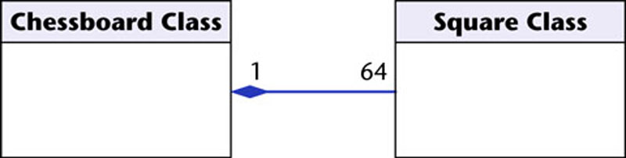
OO Relationships: Composition
Class W
Association
  Models the part–whole relationship
Composition
  Also models the part–whole relationship but, in addition, Every part may belong to only one whole, and If the whole is deleted, so are the parts
Example:
A number of different chess boards: Each square belongs to only one board. If a chess board is thrown away, all 64 squares on that board go as well.
Whole Class
Class P₁
Class P₂
Part Classes
[From Dr.David A. Workman]
Example
Figure 16.7
The McGraw-Hill Companies, 2005

Slide 24
OO Relationships: Aggregation
Container Class
Aggregation:
expresses a relationship among instances of related classes. It is a specific kind of Container-Containee relationship.
express a more informal relationship than composition expresses.
Aggregation is appropriate when Container and Containees have no special access privileges to each other.
Class C
AGGREGATION
Class E₁
Class E₂
Containee Classes
Example
Bag
Apples
Milk
[From Dr.David A. Workman]

Slide 25
Aggregation vs. Composition
  Composition is really a strong form of association
  components have only one owner
  components cannot exist independent of their owner
  components live or die with their owner
  e.g. Each car has an engine that can not be shared with other cars.
  Aggregations
  may form "part of" the association, but may not be essential to it. They may also exist independent of the aggregate. e.g. Apples may exist independent of the bag.

Slide 26
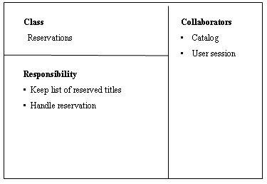
Good Practice: CRC Card
Class Responsibility Collaborator
easy to describe how classes work by moving cards around; allows to quickly consider alternatives.

Slide 27
Interaction Diagrams
show how objects interact with one another
UML supports two types of interaction diagrams
  Sequence diagrams
  Collaboration diagrams

Slide 28
Sequence Diagram(make a phone call)
Caller
Phone
Recipient
Picks up
Dial tone
Dial
Ring notification
Ring
Picks up
Hello

Slide 29
Sequence Diagram:Object interaction
A
B
Self-Call: A message that an
Object sends to itself.
Condition: indicates when a message is sent. The message is sent only if the condition is true.
Synchronous
Asynchronous
Transmission delayed
Condition
[condition] remove()
Iteration
*[for each] remove()
Self-Call

Slide 30
Sequence Diagrams – Object Life Spans
Creation
  Create message
  Object life starts at that point
Activation
  Symbolized by rectangular stripes
  Place on the lifeline where object is activated.
  Rectangle also denotes when object is deactivated.
Deletion
  Placing an ‘X’ on lifeline
  Object’s life ends at that point
A
Create
B
Activation bar
X
Return
Deletion
Lifeline

Slide 31
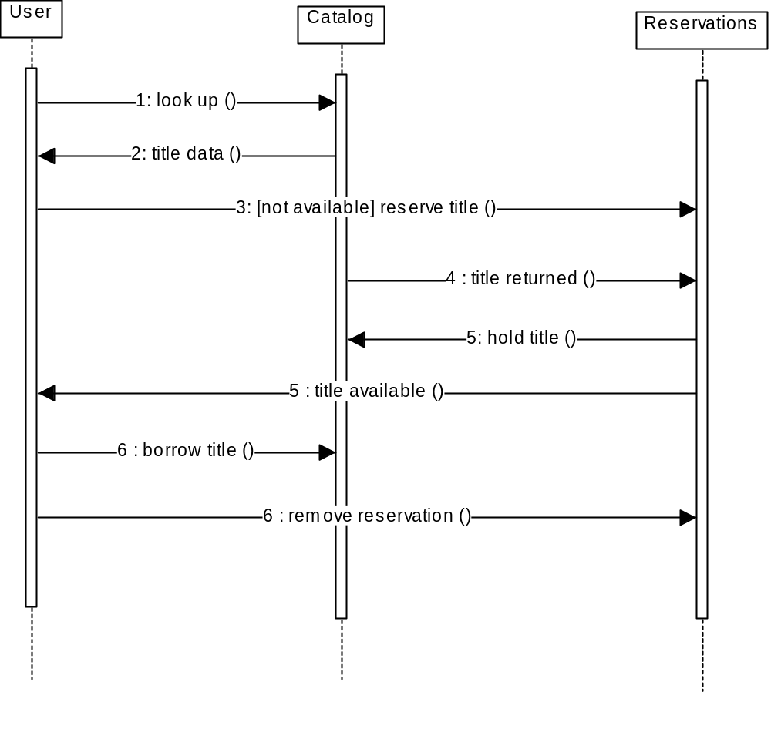
Sequence Diagram
Message
Sequence diagrams demonstrate the behavior of objects in a use case by describing the objects and the messages they pass.
The horizontal dimension shows the objects participating in the interaction.
The vertical arrangement of messages indicates their order.
The labels may contain the seq. # to indicate concurrency.

Slide 32
Interaction Diagrams: Collaboration diagrams
start
6: remove reservation
3 : [not available] reserve title
User
Reservations
6 : borrow title
5: title available
2: title data
1: look up
4 : title returned
Catalog
5 : hold title
Collaboration diagrams are equivalent to sequence diagrams. All the features of sequence diagrams are equally applicable to collaboration diagrams
Use a sequence diagram when the transfer of information is the focus of attention
Use a collaboration diagram when concentrating on the classes

Slide 33
State Diagrams (Billing Example)
State Diagrams show the sequences of states an object goes through during its life cycle in response to stimuli, together with its responses and actions; an abstraction of all possible behaviors.
Start
End
Unpaid
Paid
Invoice created
paying
Invoice destroying

Slide 34
State Diagrams (Traffic light example)
Traffic Light
Start
State
Red
Transition
Yellow timer expires
Car trips sensor
Yellow
Green timer expires
Green
Event

Slide 35
Conclusion
UML is a standardized specification language for object modeling
Several UML diagrams:
use-case diagram: a number of use cases (use case models the interaction between actors and software)
Class diagram: a model of classes showing the static relationships among them including association and generalization.
Sequence diagram: shows the way objects interact with one another as messages are passed between them. Dynamic model
State diagram: shows states, events that cause transitions between states. Another dynamic model reflecting the behavior of objects and how they react to specific event
There are several UML tools available

